Slide 1
Popular Programming Tech
Part 10
Packages and Go Tools

Slide 2
Learning Objective
LO 2 : Apply GO programming language techniques and libraries

Slide 3
Outline
Introduction
Import paths
Package declaration
Blank imports
Packages and naming
The Go tools

Slide 4
Packages and Go Tools
Go comes with ov er 100 standard packages that provide the foundations for most applications
The Go community, a thriving ecosystem of package design, sharing, reuse, and improvement, has published many more, and you can find a searchable index of them at http://godoc.org.
Go also comes with the go tool, a sophisticated but simple-to-use command for managing workspaces of Go packages

Slide 5
Introduction
The purpose of any package system is to make the design and maintenance of large programs practical by grouping related features together into units that can be easily understood and changed, independent of the other packages of the program
This modularity allows packages to be shared and reused by different projects, distributed within an organization, or made available to the wider world.
Each package defines a distinct name space that encloses its identifiers
Each name is associated wit h a particular package, letting us choose short, clear names for the types, functions, and so on that we use most often, without creating conflicts with other parts of the program.

Slide 6
Packages also provide encapsulation by controlling which names are visible or exported outside the package
Restricting the visibility of package members hides the helper functions and types behind the package’s API, allowing the package maintainer to change the implementation with confidence that no code outside the package will be affected
Restricting visibility also hides variables so that clients can access and update them only through exported functions that preserve internal invariants or enforce mutual exclusion in a concurrent program

Slide 7
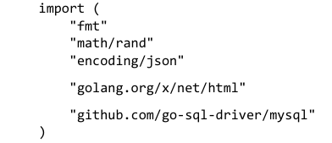
Import Paths
Each package is identified by a unique string called its import pat h. Import paths are the strings that appear in import declarations

Slide 8
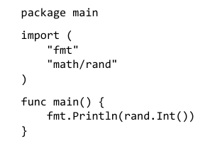
Package Declaration
A package declaration is required at the start of every Go source file
Its main purpose is to determine the default identifier for that package (called the package name) when it is imported by another package

Slide 9
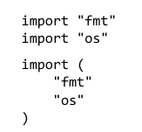
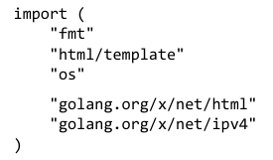
Import Declaration
A Go source file may contain zero or more import declarations immediately after the package declaration and before the first non-import declaration
Each import declaration may specify the import path of a single package, or multiple packages in a parenthesized list

Slide 10

If we need to import two packages whose names are the same, like math/rand and crypto/rand, into a third package, the import declaration must specify an alternative name for at least one of them to avoid a conflict. This is called a renaming import

Slide 11
Blank Import
It is an error to import a package into a file but not refer to the name it defines within that file
However, on occasion we must import a package merely for the side effects of doing so
import _ "image/png" // register PNG decoder

Slide 12
Packages and Naming
When creating a package, keep its name short, but not so short as to be cryptic
The most frequently used packages in the standard library are named bufio, bytes, flag, fmt, http, io, json, os, sort, sync, and time
Be descriptive and unambiguous where possible
Package names usually take the singular form
Avoid package names that already have other connotations

Slide 13
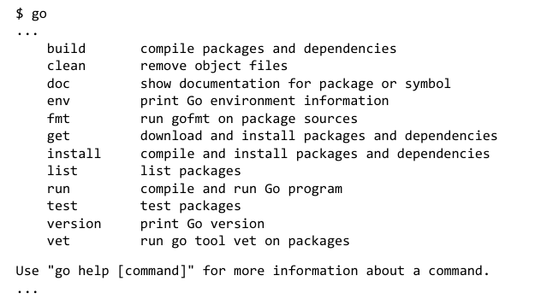
The Go Tool
The go tool combines the features of a diverse set of tools int o one command set

Slide 14
Workspace Organization
The only configuration most users ever need is the GOPATH environment variable, which specifies the root of the workspace.
When switching to a different workspace, users update the value of GOPATH. For ins tance, we set GOPATH to $HOME/gobook while working on this book:
$ export GOPATH=$HOME/gobook
$ go get gopl.io/...

Slide 15
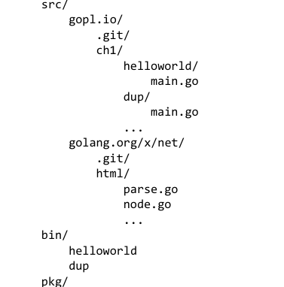
Tree Directories of GoPath
GOPATH has three subdirectories. The src subdirectory holds source code. Each package
resides in a directory whose name relative to $GOPATH/src is the package’s import path, such
as gopl.io/ch1/helloworld

Slide 16

Downloading Packages
When using the go tool, a package’s import path indicates not only where to find it in the local workspace, but where to find it on the Internet so that go get can retrieve and update it.
The go get command can download a single package or an entire subtree or repository using the ... notation

Slide 17
References
https://www.golangprograms.com/golang-import-and-export-struct-packages-and-interfaces.html

